Slide 1

Working With Emotion in EFT-C
Rhonda Goldman, PhD
The Chicago School
August 16 – 19, 2025
Copenhagen, Denmark

Slide 2
Plan for Workshop
Monday | Tuesday | Wednesday | Thursday
Review and setting the stage for 4 days Emotional Deepening Reactivity and Escalation | Stage 4: Restructuring Enactments Blocks & Shame spirals Homework Emotional injuries | Emotional Injuries Working with Identity-related issues such as dominance | Self-soothing and individual processes
General Format of Didactic Lecture and Discussion, Observation through Videotaped
Demonstration, and Small group practice.

Slide 3
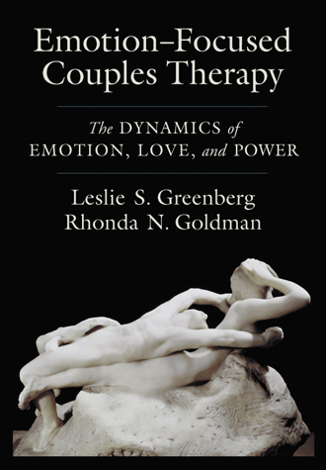

Slide 4
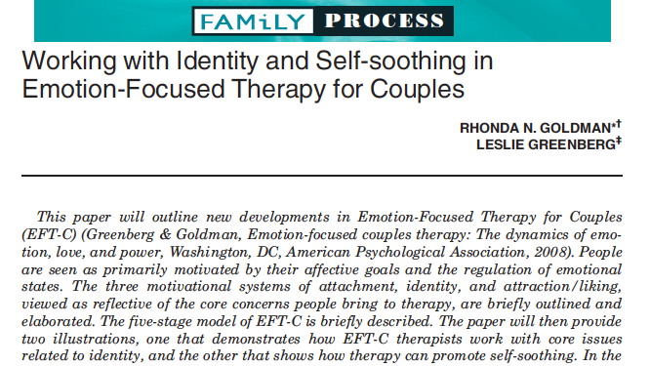

Slide 5

Conflict in couples arises out of unmet attachment and identity needs.
Over time distressed couples develop constricted interaction and emotional response patterns.
Notes:
Partners engage in all sorts of behaviors in attempts to have their emotions attended to and corresponding needs met, not all of which are effective. Because one partner’s behaviors typically elicits a complimentary response from the other partner, over time ineffective attempts at getting these core needs met can result in the couple relating in a rigid, cyclical style that causes distress.
couples’ conflict is understood as emerging most fundamentally from the painful feelings emanating from unmet adult needs for attachment (proximity, availability and responsiveness), and identity (having one’s sense of self accepted and validated) and to be ameliorated by positive feelings of attraction and liking

Slide 6


Secondary emotion (“protective”)
Primary emotion
(Adaptive or Maladaptive)
Anger
Sadness
Fear
Shame
Interest
Love
Joy
Instrumental

Slide 7


Resolution in EFT-C
Secondary emotions are unconscious attempts to avoid feeling the more vulnerable emotions activated by a situation (“survival strategies”).
Resolution occurs when the EFT therapist creates a safe environment to help the couple reveal their underlying vulnerable emotions and respond constructively to those of their partner.
Notes:
Vulnerable:
Letting go of self-protection and revealing sensitive or painful aspects of one’s experience. (take a risk in being hurt)
Empirical evidence shows that Couples consider sessions in which vulnerable emotion was expressed as being particularly helpful (McKinnon & Greenberg, 2013).
Show video from youtube about how having communication skills does not solve the problem.
Ask them what they see in the video as needing to change between the two partners.
What’s she expressing? what's she feeling?
We will come back to discussing what we do in EFT-C.
Solving relationship difficulties with communication skills
https://www.youtube.com/watch?v=nGDXN4H98uc
(About 3 min - watch until the end)
Scene of a couple fighting and highlights the depth of their conflict (seems like a dominance issue)

Slide 8
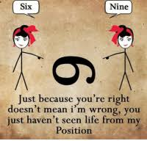

Slide 9
Stages of Treatment
The Five stages and Fourteen Steps of EFT-C
Greenberg & Goldman (2008)

Slide 10
Five stages of eft-C
Validation and Alliance Formation
1
Negative Cycle De-escalation
2
Accessing Underlying Feelings
3
Restructure the Interaction and the bond
4
Consolidation and Integration
5

Slide 11
Stage 1: Validation and alliance formation
1. Empathize with and validate each partner’s pain
2. Delineate conflict issues. Assess how these issues reflect core problems in the areas of connectedness and identity.

Slide 12
Stage 2: Negative cycle de-escalation
3. Identify the negative interactional cycle, and each partner’s position in that cycle. Externalize the problem as the cycle.
1
4. Identify the unacknowledged attachment/ identity related emotions underlying the interactional positions.
2
5. Reframe the problem in terms of cycle and underlying feelings and needs.
3
6. Identify historical origins of sensitivities and vulnerabilities with respect to primary negative interactional cycle.

Slide 13
Stage 3: Accessing underlying feelings
7. Access unacknowledged feelings/needs underlying interactional positions and express them
  Softening of blamer- sadness, loneliness, anxiety
  Withdrawer re-engagement - anxiety, anger
  Dominant goes one down – shame, fear
  Submissive asserts – fear, inadequacy, anger
8. Identify & overcome blocks to accessing.
9. Promote identification with disowned needs/aspects of self, integrating these into relationship interactions.

Slide 14

Stage 4: restructure the interaction and the bond
10. Promote acceptance by the other of partner’s experience/aspects of self.
11. Facilitate the expression of needs and wants to restructure the interaction, and create emotional engagement.
- Promote softening events
- Structure emotional engagement- bonding and validating events.
12. Promote self soothing and emotion transformation in each partner.

Slide 15
Stage 5: consolidation and integration
13. Facilitate the emergence of new interactions and solutions to problematic interactions and issues.
14. Enact new positions and consolidate new narratives.

Slide 16
Basic Framework: Therapist Responses and INterventions

Slide 17

Rapid and automatic response
Automatic, amygdala based, emergency emotions, are at the core of threats to identity and security and are key generators of conflict.
Notes:
1. Conflict comes from threats to attachment and identity, and failures to solve struggles for security and validation.
3.Conflict results from secondary emotion-activated escalating interactions that rigidify into negative interactional cycles.

Slide 18
The Basics of EFT Intervention
A) The Therapeutic relationship
1. Presence
2. Empathy
3. The Alliance
B) Access reformulate emotional experiencing
1. Responding
2. Directing/Guiding
C) Changing interactional positions
1. Reframing
2. Restructuring

Slide 19
Interactional Stances
Lean in. Warm close.
Sit back. Distant and descriptive
Direct. Guide enactments

Slide 20
Basic Interactional Interventions
Tracking & reflecting patterns & cycles of interactions
Framing & reframing problems in terms of negative cycles (attachment/identity) responses.
Using enactments to shape interactions:
plan and oversee events to modify, step by step, each
partner’s interactional position.

Slide 21
Identify Negative Cycle
Work with the couple to describe the cycle
Identify who is pursuing for emotional closeness or dominating and who is protecting against intrusion or submitting
Identify the Cycle as well as Interactional Positions
In both partners:
    Behaviours
    Perceptions - View of Self and of Partner
    Secondary – Reactive Emotions
    Primary Emotions
    Attachment and Identity Needs

Slide 22
Importance and subtly of language, vocal quality
Are Clients Expressing Primary Vulnerable, Adaptive Emotions? Maladaptive Emotions that need to be transformed? Secondary Emotions that need to be bypassed?
C: “How could you hurt me like that? I was so hurt!” (crying but sound angry, expressing it in a blaming way)
C: “That was so awful, you just left me!” (crying but accusing tone)
Notes:
--I statements are important, not you did this and that. TONE and Vocal quality are so important.
--This Eg. Lack of congruence between hurt words and angry vocal tone usually tells you it’s not primary (usually anger covers something vulnerable).
--Sometimes you think partner A has been vulnerable but partner B gets defensive and then you are surprised.
--Sometimes a partner’s reaction is appropriately not accepting and it makes you think, “what did I miss?”.

Slide 23
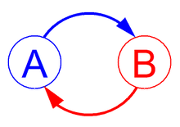
The EFT Cycle
Perceptions/Meaning (see?) Perceptions/Meaning
Behaviour (do?) Behaviour Secondary Emotion (feel?) Secondary Emotion
Primary Emotion (emotion?) Primary Emotion
Unmet Attachment & Unmet Attachment & Identity Needs(need?) Identity Needs

Slide 24
Identifying the Cycle
Continually return to identification of the cycle and naming the position that the partners rely on when they are feeling threatened, vulnerable or confronted i.e. when their attachment or identity needs are activated.
Need to continually attune to underlying attachment and identity needs and conceptualize the partners’ experience from their unmet needs.
Access unacknowledged feelings that underlie their position in the cycle. Ask yourself what would you feel in response to partners’ positions and conjecture

Slide 25
Identifying the Pursuer and Withdrawer
Look for examples and stories that describe who is pursuing for emotional closeness who distances, who defines who defers?
You will be observing reactive behaviors and secondary emotions, so you must find search behind the protective/defensive stances at the underlying emotions to find the positions and the original cycle.
There can be two cycles.
The basic cycle and then a reactive cycle given the circumstances of the relationship.
A second less dominant cycle which is not the presenting problem

Slide 26
Reframing Problems in terms of Negative Cycles
3 PERSPECTIVES
Systemic/Interactional Perspective:
  each partner helps create and is a victim of the
  other’s behavior (affiliation/influence)
Emotion Perspective:
  secondary emotions
  primary underlying emotional experience
Motivational Perspective
  attachment/identity perspective/affection
  closeness/self esteem or worth/liking

Slide 27
Reframe in terms of underlying feelings and needs
C: (wife who is running into husband’s lack of responsiveness): It’s like you try this one and boom, there’s a wall. Another one, another wall. I have run out of avenues. I cannot get through to him.
T: It’s like you end up feeling so hurt and alone and needy (reframing in terms of underlying feelings and needs.)

Slide 28
EFT Reframes
Validate each partner’s position before you reframe as it is a challenge to their reality
Each partner needs to have started to name their underlying emotions.
Highlight underlying adaptive feelings and needs “I distance because I am afraid of failing you or being criticized.” and “I become enraged with you because I can’t get you to respond to me at all.”
Reframes help partners see themselves and their partner differently

Slide 29
Examples of Emotions
(Primary & Secondary)
Pursuer
Hurt
Lonely
Sad
Unwanted
Isolated
Abandoned
Desperate
Disconnected
Deprived
Longing
Distancer
Rejected
Overwhelmed
Numb, Frozen
Afraid, Scared
Not Wanted or Desired
Empty
Walled off

Slide 30
Examples of Emotions
(Primary & Secondary)
Dominant
Angry
Contempt
Arrogant
Right
Underlying Shame
Underlying fear of loss of control
Invisible
Withdrawer
Inadequate
Afraid of failure
Judged
Criticized
Afraid
Unsure
Shame
Unexpressed anger

